Slide 1
Airport Data Analysis

Slide 2
Objective:
Learn how to develop airport and airline data analysis dashboard development project in tableau for identifying where the various flights are going and what is the most busy and most lengthy routes from the airport. Also create a hidden filter within the dashboard Find key metrics and factors and show the meaningful relationships between attributes.

Slide 3
Benefits:
-Identifying where the various flights
-The most busy Flights
-The most lengthy routes
-Create a hidden filter within the dashboard

Slide 4
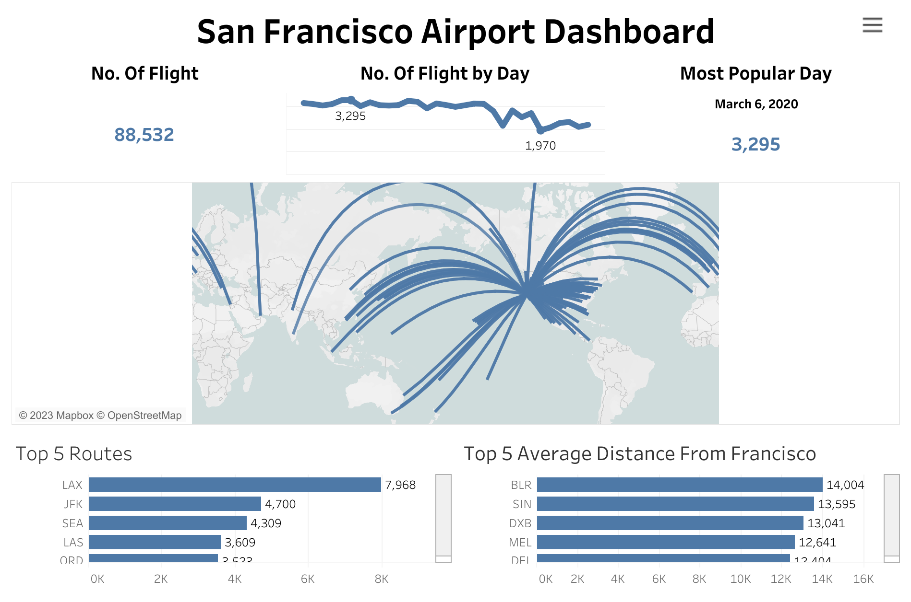

Slide 5
Approaches:
The tool used in this project is tableau.
-The data was downloaded via the link provided.
-After uploading the data in tableau public, the columns and details about the data was explored.
-After analysing the various routes and most busy and lenthy routes, the dashboard was created using hidden filters.
-Also create a hidden filter within the dashboard.

Slide 6
Acknowledgements
Project Title :- Airport Data Analysis
Technologies :- Business Intelligence
Domain :- Aviation
Project Difficulties level :- Advanced

